Slide 1
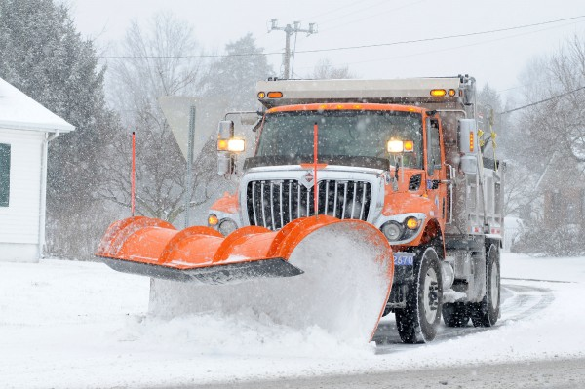
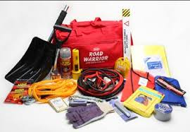
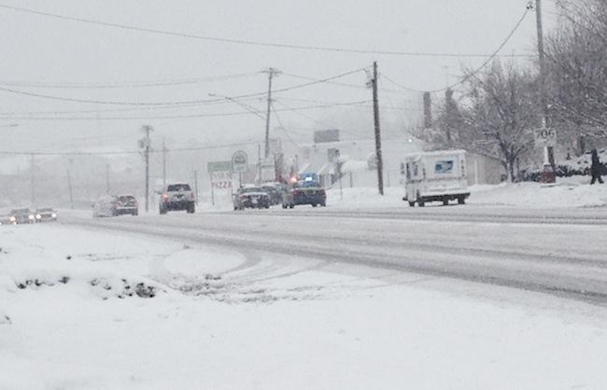
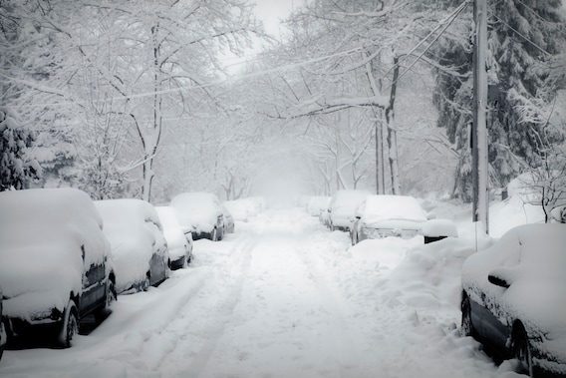
Winter Preparedness Brief
DECCC
November 18, 2020

Slide 2
Winter Preparedness
Winter Storm Effects
NWS Weather Definitions
Driving Restrictions
Preparedness tips
Helpful Sites

Slide 3
Winter Storm
A Winter Storm is a combination of winter precipitation with an impact of hazardous conditions.
The main hazards associated with winter storms are: High winds, freezing rain or sleet, heavy snowfall, and dangerously cold temperatures.
Winter storms can create impassable roadways, loss of utilities and services, property damage, and disruption of business/economy.

Slide 4
NWS Winter Weather Definitions
Advisory: Conditions are expected which could impact travel and other activities. If caution is used, should not be life threatening
Watch: Issued when significant winter precipitation is possible within 24 to 48 hours. Alert of hazardous winter weather could occur. Issued for winter storms, heavy snow or blizzards.

Slide 5
Definitions Cont.
Warning: Issued when winter precipitation could lead to a threat to life or property. Indicators: 4+ inches of snow is expected in the next 12 hours; 6+ inches of snow in the next 24 hours, or ¼ inch+ of ice accumulation is expected. The most serious winter weather message – take action!
Blizzard Warning: Sustained wind speeds of at least 35 MPH are accompanied by considerable falling and/or blowing snow. Driving conditions become extremely difficult and dangerous.

Slide 6
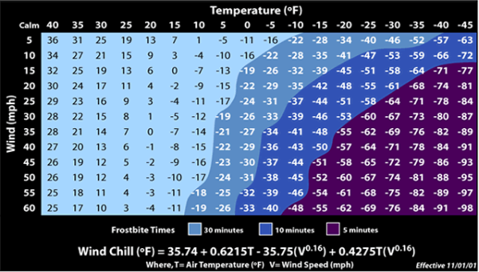
Definitions Cont.
Wind Chill: Increased wind speeds accelerate heat loss from exposed skin

Slide 7
https://youtu.be/-srUpzCmBrM
Check out the above link for humorous take on winter driving.

Slide 8
Driving Restrictions/Waiver
20 Delaware Code, Section 3116; The Governor or a designee may implement driving restrictions during a state of emergency
Applies to use/operation of motor vehicles on Delaware roads to include highways, roadways, and private roads
Separate levels may be issued throughout the State based on severity of conditions in given areas

Slide 9
Driving Restrictions
Level I Driving Warning – Persons operating a motor vehicle shall exercise extra caution.
Level II Driving Restriction – Driving is restricted to essential personnel and individuals with driving waivers due to safety, health, or business necessity.
Level III Driving Ban – Driving is restricted to those designated as first responders and essential personnel only. Driving waivers does not apply

Slide 10
Winter Preparedness/Safety
Winterize home
Have heating system checked and chimney cleaned/inspected
Fuel for alternate heat source(s)
Bottled water, non-perishable food, batteries
Fire extinguisher if portable heating units are used
Be aware of dangers of Carbon Monoxide
Clear snow from intake/exhaust vents
Avoid overexertion when shoveling snow

Slide 11
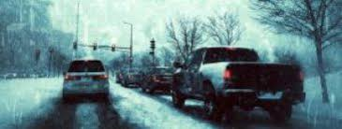
Winter Preparedness/Safety Cont.
Vehicle maint; tires, anti-freeze, windshield washer
Keep gas tank above half; prevents ice in fuel line
Have emergency supplies in vehicle if traveling:
Warm clothes, boots, shovel, sand
If you become stranded; turn on flashers, run engine intermittently to stay warm
“Make a Plan – Make a Kit”

Slide 12
Helpful Websites
PrepareDE - https://www.preparede.org/
FEMA Ready - https://www.ready.gov/
NWS Winter Storms Pamphlet - https://www.weather.gov/media/safety/Winter_Storms2008.pdf
Mt Holly NWS - https://www.weather.gov/phi/
Driving Restrictions - https://dema.delaware.gov/drivingRestrictions/index.shtml
DEMA - https://dema.delaware.gov/

Slide 13
https://www.youtube.com/watch?v=wkDvqQKGgDA

Slide 14
Questions
Q: What is the difference of between Essential personal and Mission Critical personnel (or COOP Essential)?
A: State assigned Essential Personnel are permitted and expected to drive during the Level II driving ban. This status is set by DHR and cannot be changed the individual organizations. COOP Essential personal are those people that are designated as employees that perform processes that are a priority to an organization. These employees are NOT permitted to drive during the ban unless they are also State Essential personnel.

Slide 15
Questions
Comment
Another item to consider in winter preparations, is battery back-ups for internet routers. With many state employees working remotely, concerns regarding reporting to an office (travel in bad weather) will instead be replaced with employees whose bandwidth may be interrupted due to storms. This should be considered when evaluating your COOP plans and determining which employees are likely to be impacted by such events and the repercussions.

Slide 16
Thank You
Edward “Tony” Lee
Delaware Emergency Management Agency (DEMA)
Principal Planner
(302) 659-2219
Edward.lee@delaware.gov

